Slide 1

Advance Volume

Slide 2
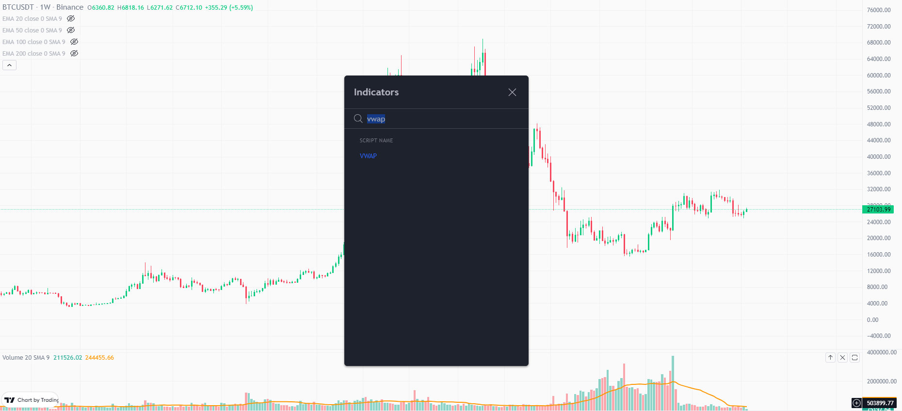
VWAP

Slide 3
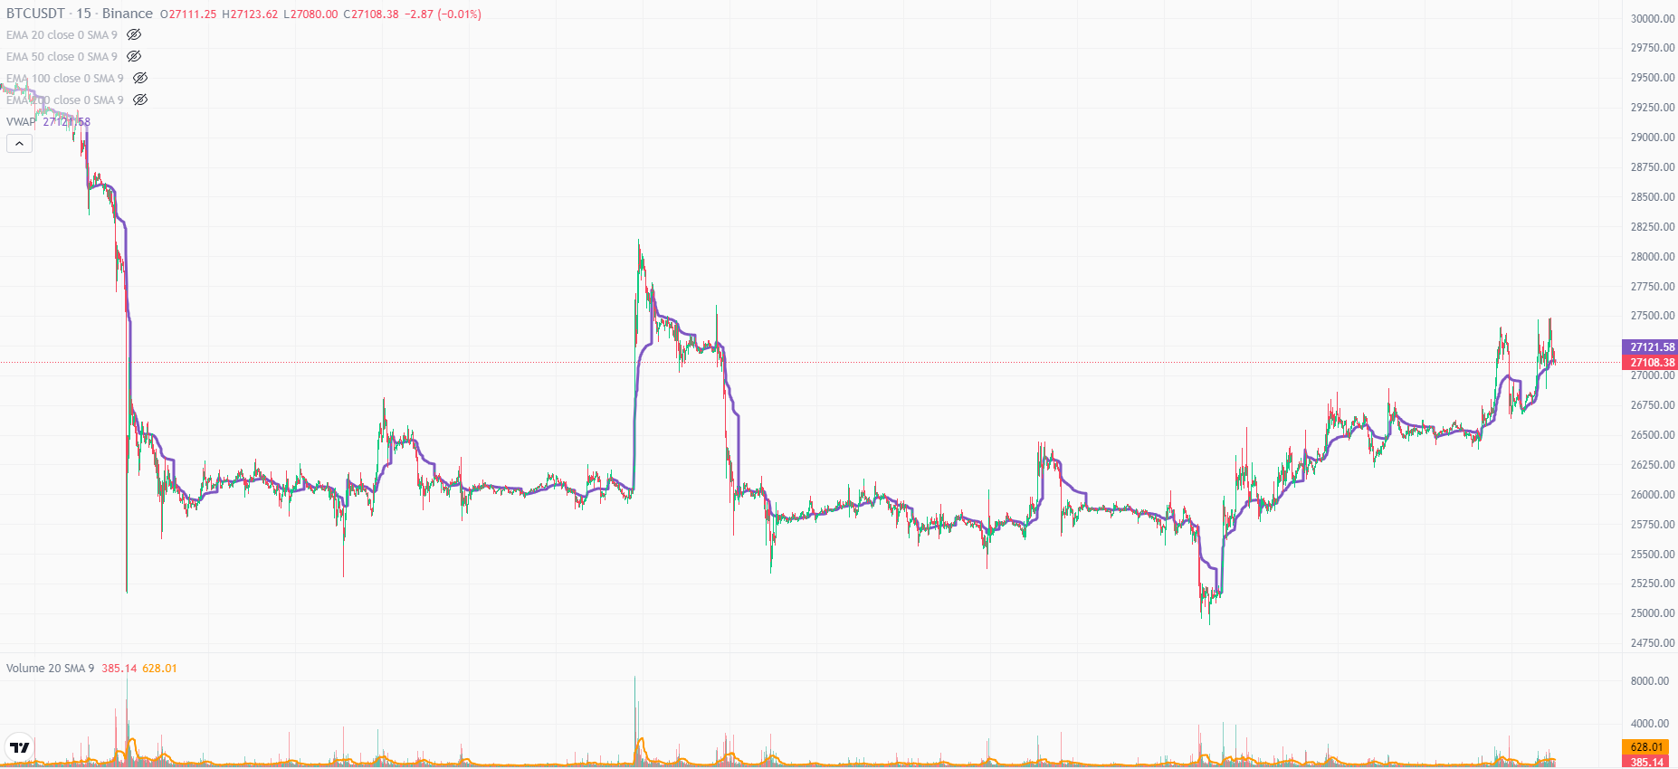
VWAP

Slide 4
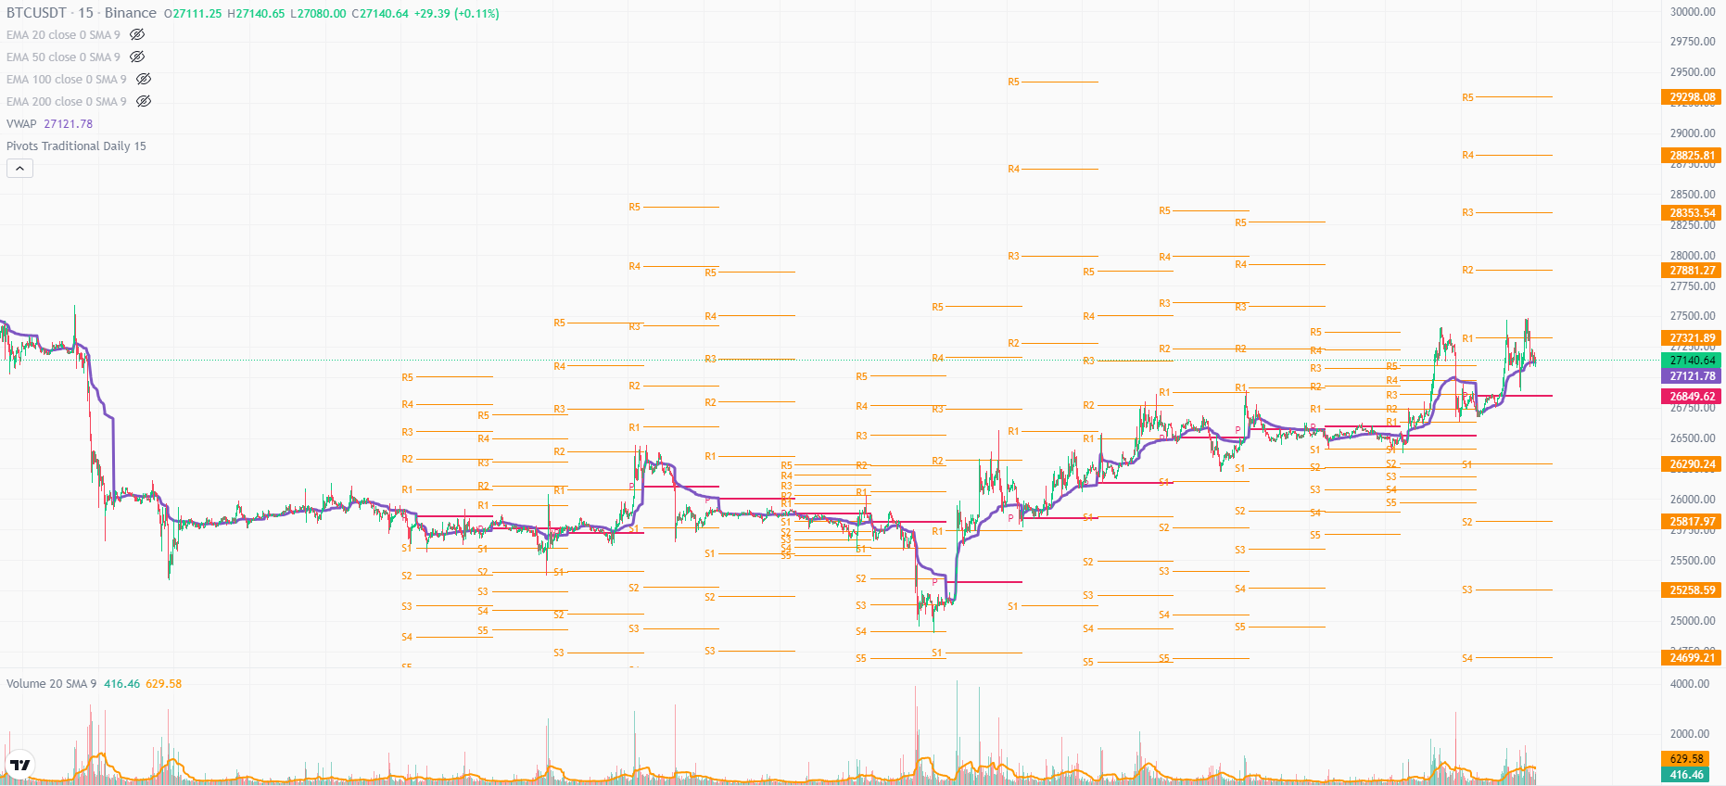
VWAP + Pivot Points

Slide 5
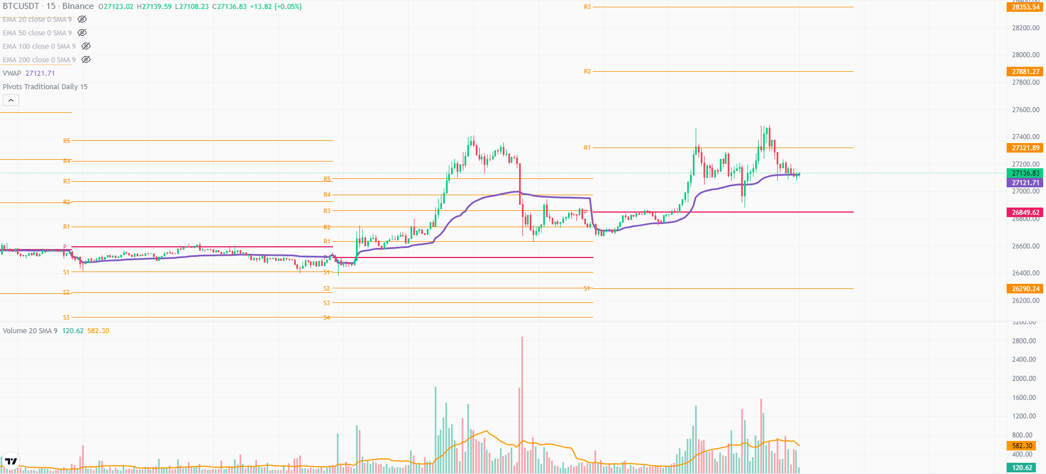
VWAP + Pivot Points - Scenario 1
Notes:
VWAP moves in all three trends.
Acts as support/resistance.
If price is going above vwap then it will be bullish.
if it’s below vwap then its bearish.
Whales may take support of VWAP to bounce upward.
Scenario 1 - Usual rally pattern is, at the start of the day, VWAP dumps (self adjustment), price takes support of VWAP, crosses pivot and rally up.

Slide 6
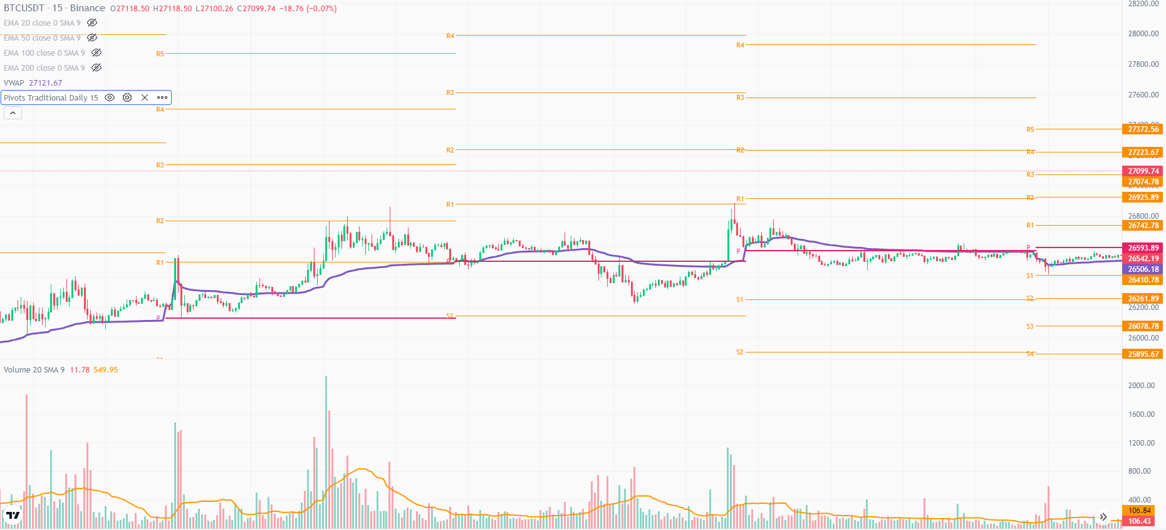
VWAP + Pivot Points - Scenario 2
Notes:
Scenario 2 - VWAP pumps upwards (self adjustment), then acts as resistance for price the whole day.

Slide 7
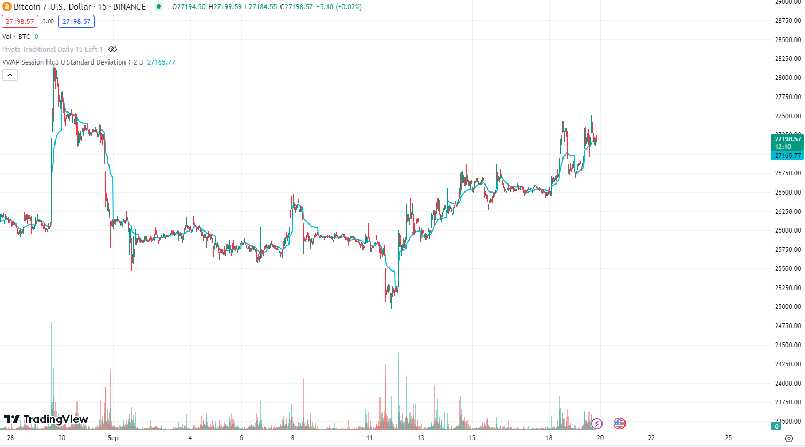
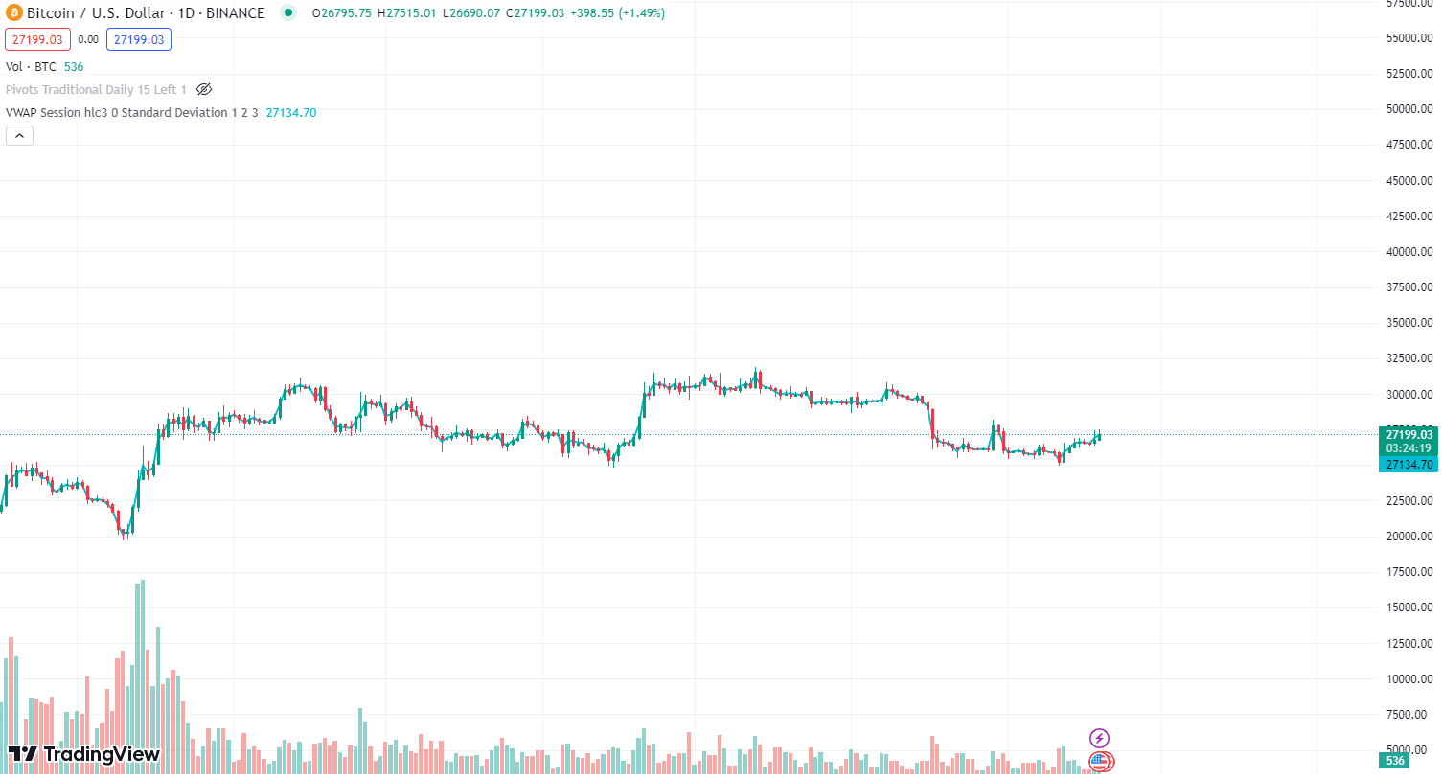
Problem?
Notes:
VWAP doesn’t work properly for bigger time frames.

Slide 8
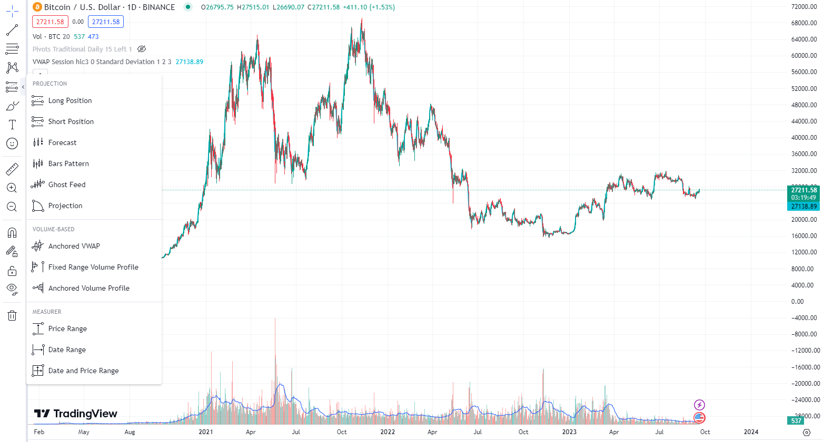
Anchored VWAP
Notes:
VWAP is an intraday tool. So at bigger timeframes, 4h, 1D, 1W it doesn’t work that well.

Slide 9
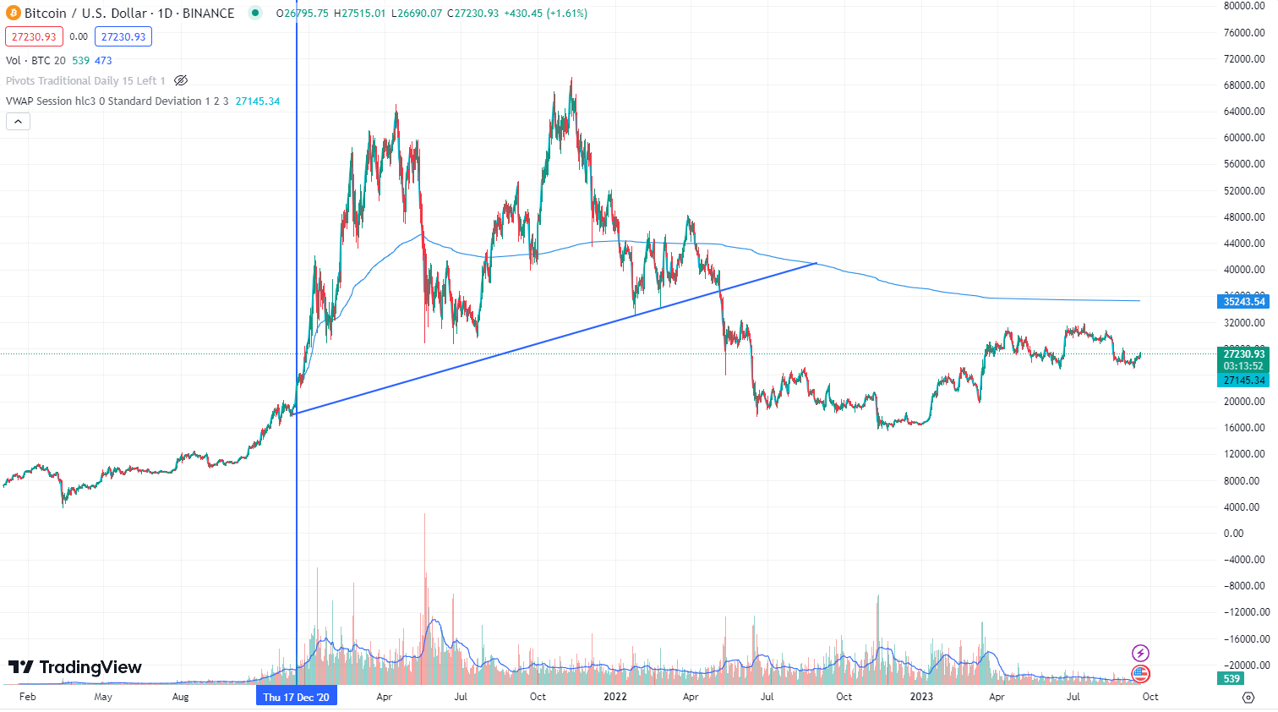
Anchored VWAP

Slide 10
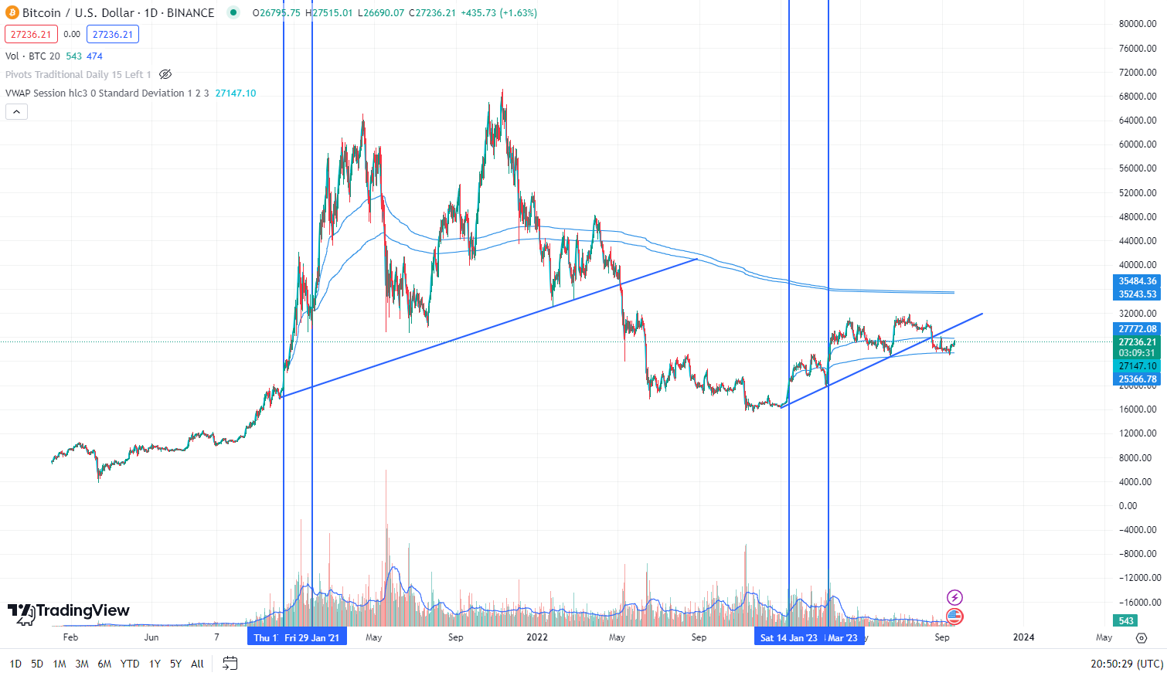
Anchored VWAP

Slide 11
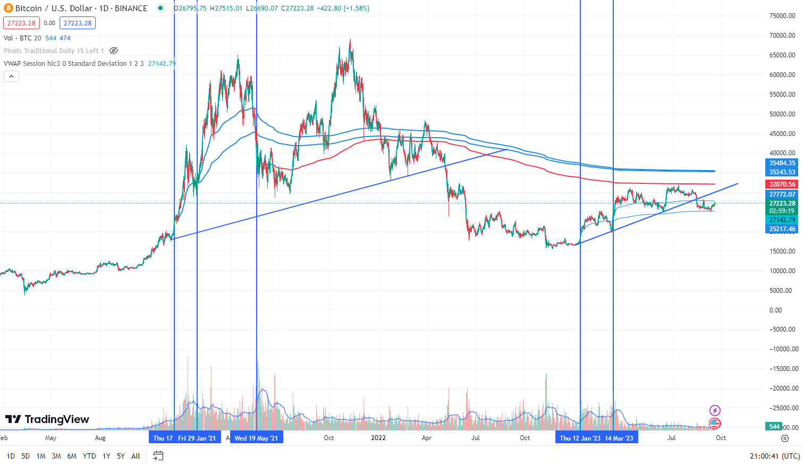
Anchored VWAP

Slide 12
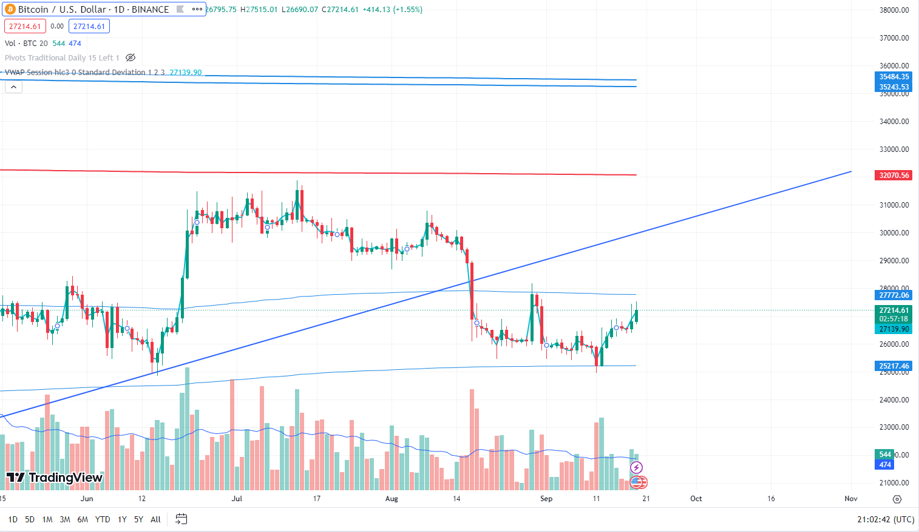
Anchored VWAP

